Slide 1

MySQL

Slide 2
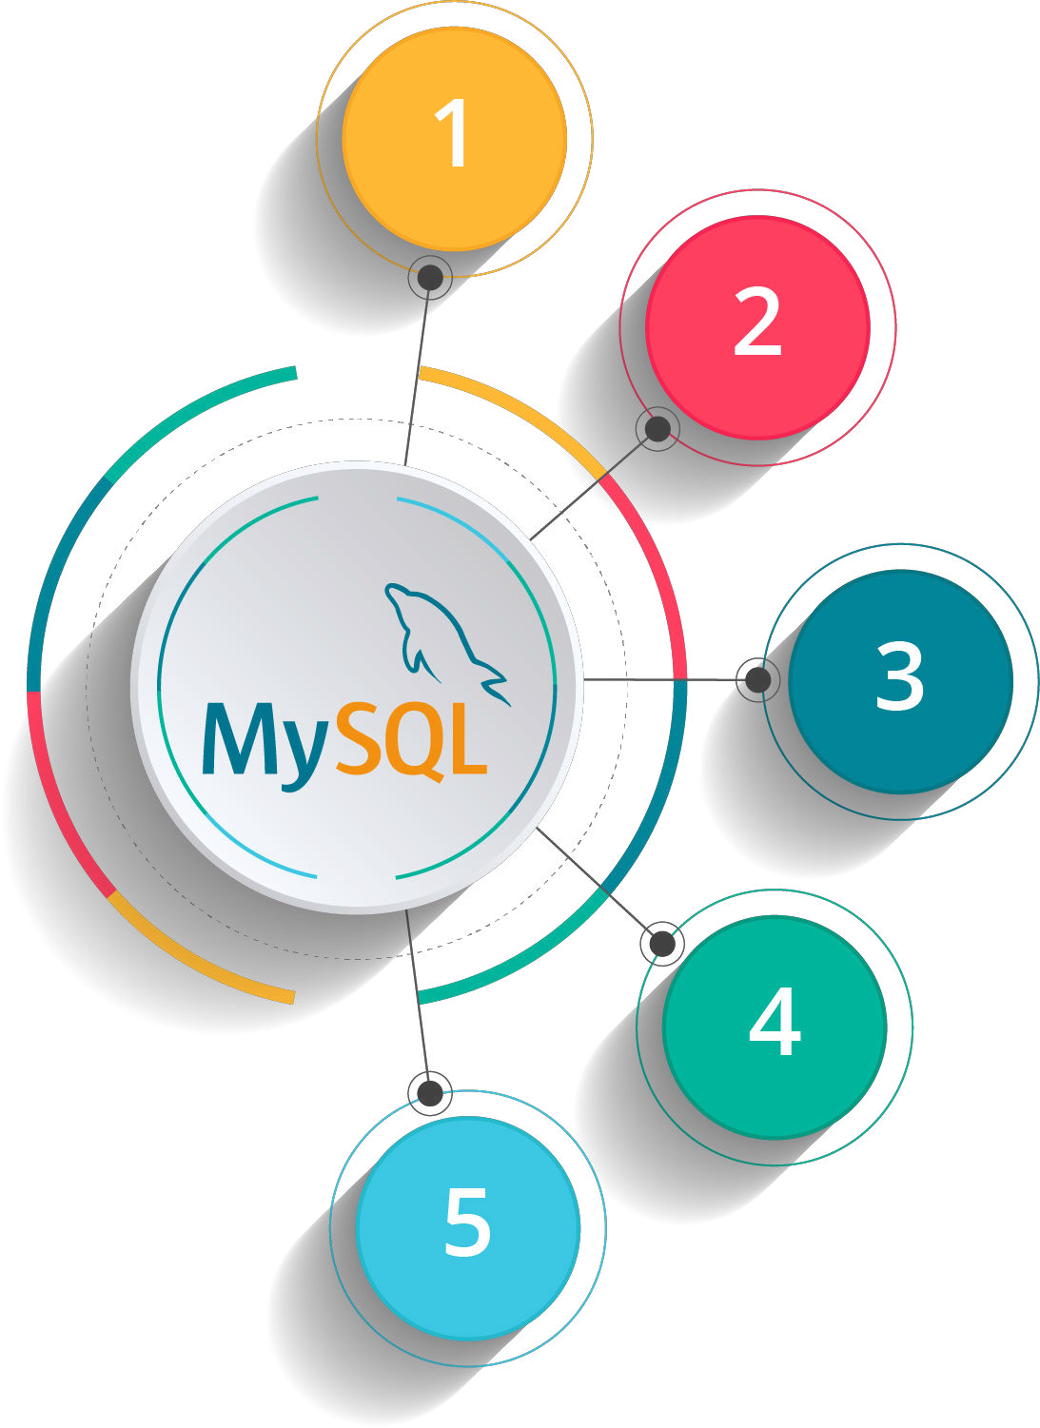
Course Outline
DDL (Data Definitions Language) Commands
DML (Data Manipulation Language) Commands
Retrieve Data from Multiple Tables
Inbuilt Functions in SQL
Basics: MySQL Intro
Create Advance Database Objects

Slide 3


MySQL Intro

Slide 4

Objectives
After completing this module, you should be able to:
What is MySQL?
Reason for Popularity of MySQL
MySQL Versions
Features of MySQL
Download MySQL

Slide 5

What is MySQL?
MySQL is a relational database management system. It is open-source and free.
MySQL is a fast, easy to use relational database. It is currently the most popular open-source database. It is very commonly used in conjunction with PHP scripts to create powerful and dynamic server-side applications.
MySQL is used for many small and big businesses. It is developed, marketed and supported by MySQL AB, a Swedish company. It is written in C and C++.

Slide 6
Reasons for Popularity MySQL
MySQL is an open-source database so you don't have to pay a single penny to use it.
MySQL is a very powerful program so it can handle a large set of functionality of the most expensive and powerful database packages.
MySQL is customizable because it is an open source database and the open-source GPL license facilitates programmers to modify the SQL software according to their own specific environment.
MySQL is quicker than other databases so it can work well even with the large data set.
MySQL supports many operating systems with many languages like PHP, PERL, C, C++, JAVA, etc.
MySQL uses a standard form of the well-known SQL data language.
MySQL is very friendly with PHP, the most popular language for web development.
MySQL supports large databases, up to 50 million rows or more in a table. The default file size limit for a table is 4GB, but you can increase this (if your operating system can handle it) to a theoretical limit of 8 million terabytes.

Slide 7
MySQL Versions
Milestones in MySQL development included:
First internal release on 23 May 1995
Version 3.19: End of 1996, from www.tcx.se
Version 3.20: January 1997
Windows version was released on 8 January 1998 for Windows 95 and NT
Version 3.21: production release 1998, from www.mysql.com
Version 3.22: alpha, beta from 1998
Version 3.23: beta from June 2000, production release 22 January 2001
Version 4.0: beta from August 2002, production release March 2003 (unions).
Version 4.01: beta from August 2003, adopts MySQL for database tracking
Version 4.1: beta from June 2004, production release October 2004 (R-trees and B-trees, subqueries, prepared statements).
Version 5.0: beta from March 2005, production release October 2005 (cursors, stored procedures, triggers, views, XA transactions).

Slide 8
MySQL Versions..
Sun Microsystems acquired MySQL AB in 2008.
Version 5.1: production release 27 November 2008 (event scheduler, partitioning, plugin API, row-based replication, server log tables)
Version 5.1 contained 20 known crashing and wrong result bugs in addition to the 35 present in version 5.0 (almost all fixed as of release 5.1.51).
MySQL 5.1 and 6.0-alpha showed poor performance when used for data warehousing – partly due to its inability to utilize multiple CPU cores for processing a single query.
Oracle acquired Sun Microsystems on 27 January 2010.
The day Oracle announced the purchase of Sun, Michael "Monty" Widenius forked MySQL, launching MariaDB, and took a swath of MySQL developers with him.
MySQL Server 5.5 was generally available (as of December 2010). Enhancements and features include:
The default storage engine is InnoDB, which supports transactions and referential integrity constraints.
Improved InnoDB I/O subsystem
Improved SMP support
Semi synchronous replication.
SIGNAL and RESIGNAL statement in compliance with the SQL standard.
Support for supplementary Unicode character sets utf16, utf32, and utf8mb4.
New options for user-defined partitioning.

Slide 9
MySQL Versions..
MySQL Server 6.0.11-alpha was announced[39] on 22 May 2009 as the last release of the 6.0 line. Future MySQL Server development uses a New Release Model. Features developed for 6.0 are being incorporated into future releases.
The general availability of MySQL 5.6 was announced in February 2013. New features included performance improvements to the query optimizer, higher transactional throughput in InnoDB, new NoSQL-style memcached APIs, improvements to partitioning for querying and managing very large tables, TIMESTAMP column type that correctly stores milliseconds, improvements to replication, and better performance monitoring by expanding the data available through the PERFORMANCE_SCHEMA. The InnoDB storage engine also included support for full-text search and improved group commit performance.
The general availability of MySQL 5.7 was announced in October 2015. As of MySQL 5.7.8, August 2015, MySQL supports a native JSON data type defined by RFC 7159.
MySQL Server 8.0 was announced in April 2018, including NoSQL Document Store, atomic and crash safe DDL sentences and JSON Extended syntax, new functions, such as JSON table functions, improved sorting, and partial updates. Previous MySQL Server 8.0.0-dmr (Milestone Release) was announced 12 September 2016.

Slide 10
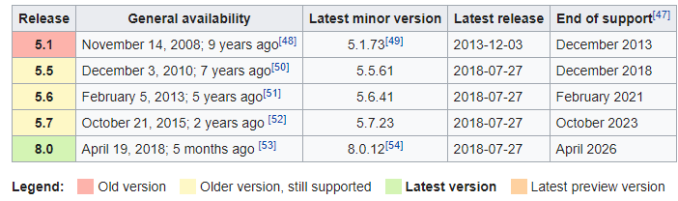
MySQL Versions - Latest

Slide 11
Features of MySQL
RDBMS
Easy to use
Secure
Client |Server Architecture
Free to download
Scalable
Compatible on Many Operating System
Allows Rollback
High Performance
High Flexibility
High Productivity

Slide 12
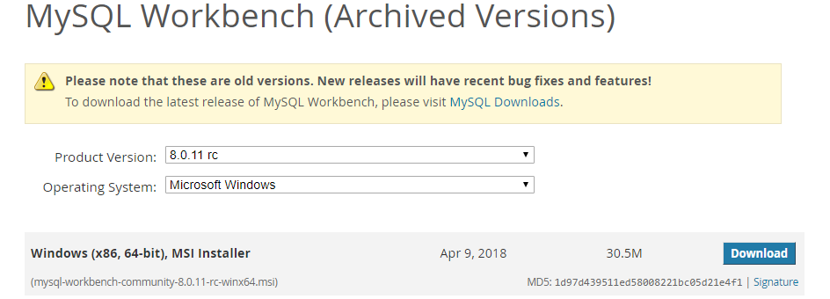
Download MySQL
For Development Purpose we can use workbench
https://downloads.mysql.com/archives/workbench/
Note: Go to MySQL official website http://www.mysql.com/downloads/

Slide 13

Summary
In this module, you should have learnt:
What is MySQL?
Reason for Popularity of MySQL
MySQL Versions
Features of MySQL
Download MySQL

Slide 14


Copyright © 2017, edureka and/or its affiliates. All rights reserved.

Slide 15

Copyright © 2017, edureka and/or its affiliates. All rights reserved.

Slide 16


